Slide 2


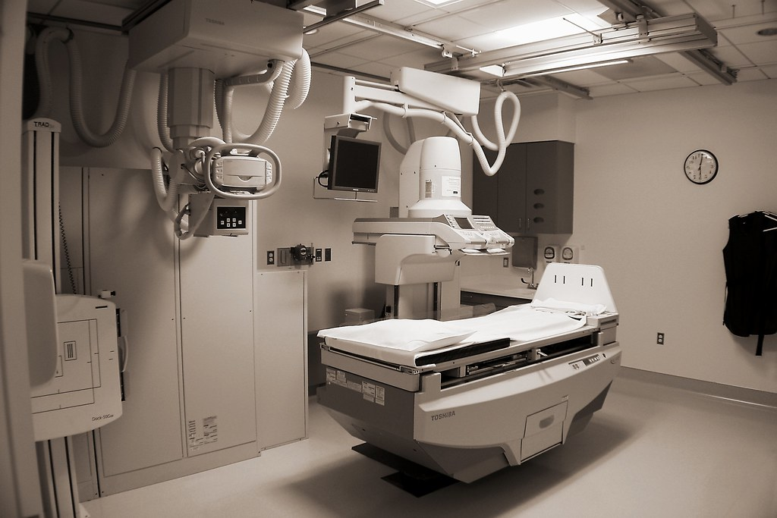
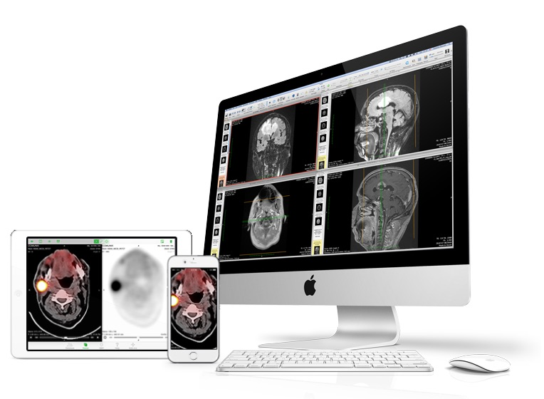


PACS
Patient Admission
(ADT HL7 )
Imaging Order
(HL7 ORM)
HL7 ORM message
Order Scheduling in RIS (CT, MRI, XRAY)
Exam
Radiology/Imaging
(Based on modality)
Patient EMR
Patient’s historical Records
PACS Server
Storage Archiving
(PACS System DICOM)
HIS
RIS
PACS
DICOM Images from PACS are linked with patient info stored in RIS
Imaging Results/Reports generated
(HL7 ORU)
PACS Client workstation/devices
(Review for reporting the DICOMs)
HL7 ORU message
DICOM Images
Doctor reviews reports

Slide 3
ENROLLMENT & ELIGIBILITY FLOW
Enrollment & Maintenance
(834 X12 )
State Medicaid Agencies
(Determine Medicaid eligibility based on MAGI)
Update Member Roster
Track Enrollment Changes
Ensure Accurate Coverage
Respond to 834
Premium Payment
(820 X12)
Acknowledgement
(999 X12)
Managed Care Organizations
(MCOs)
OR
Insurance companies
HEALTHCARE PROVIDERS/PHARMACY
SPONSOR
PAYER
Employer
Eligibility Benefit Inquiry
(270 X12)
Perform Patient Matching
Validate Coverage dates
Provider Credentialing
Validate CPT proc codes
Build eligibility response
Eligibility Benefit Response
(271 X12)

